Slide 1
AI Working Group
Status Update
November 2024

Slide 2
Today’s Agenda
Goals and Objectives
Revere Meeting Summary
Recommended Next Steps
Action List
Implementation Schedule
Questions / Discussion

Slide 3
Overall Objectives for AI Implementation
Understand “guiderails” for use
Understand potential pitfalls
Identify initial focus areas
Develop an implementation and testing plan
Develop an implementation and testing schedule
Continuous improvement

Slide 4
Who is Revere?
Similar size company to AASI
Similar use cases, workflow and business environment

Slide 5
Revere Meeting Summary
Learned the workings of LLM-based AI models
AI Adaptability: The tool itself is less important than how it’s used. Focus on enhancing roles and training people
Token Management: AI performance depends on token limits; tools like Gemini handle large documents by splitting them into manageable sections.
Accuracy Testing to gain confidence in outputs
Future Potential: Explore areas like data analysis, accuracy testing, and enhancing QA through AI.

Slide 6
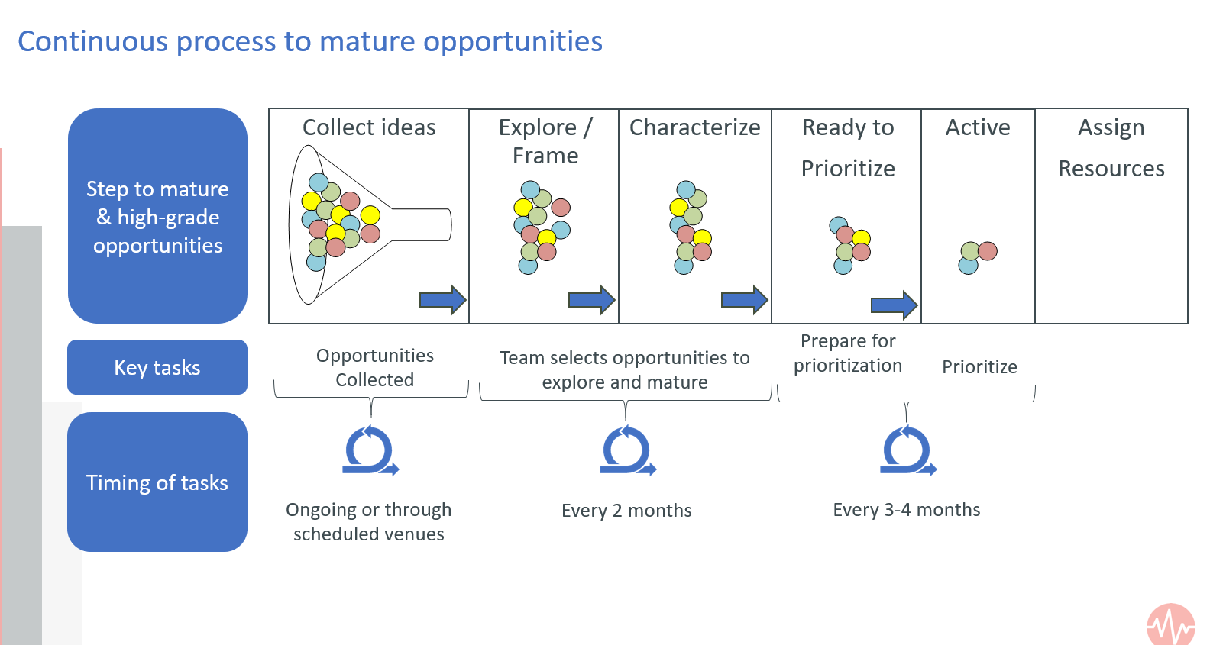
Selecting Focus Areas
Most AI initiatives fail because of failure in selecting the right projects
AI project is 15% tech, 85% people
“Buy-in” across the company
Confirmation bias can be dangerous
Seek low-hanging fruit – impact, likelihood of success

Slide 7
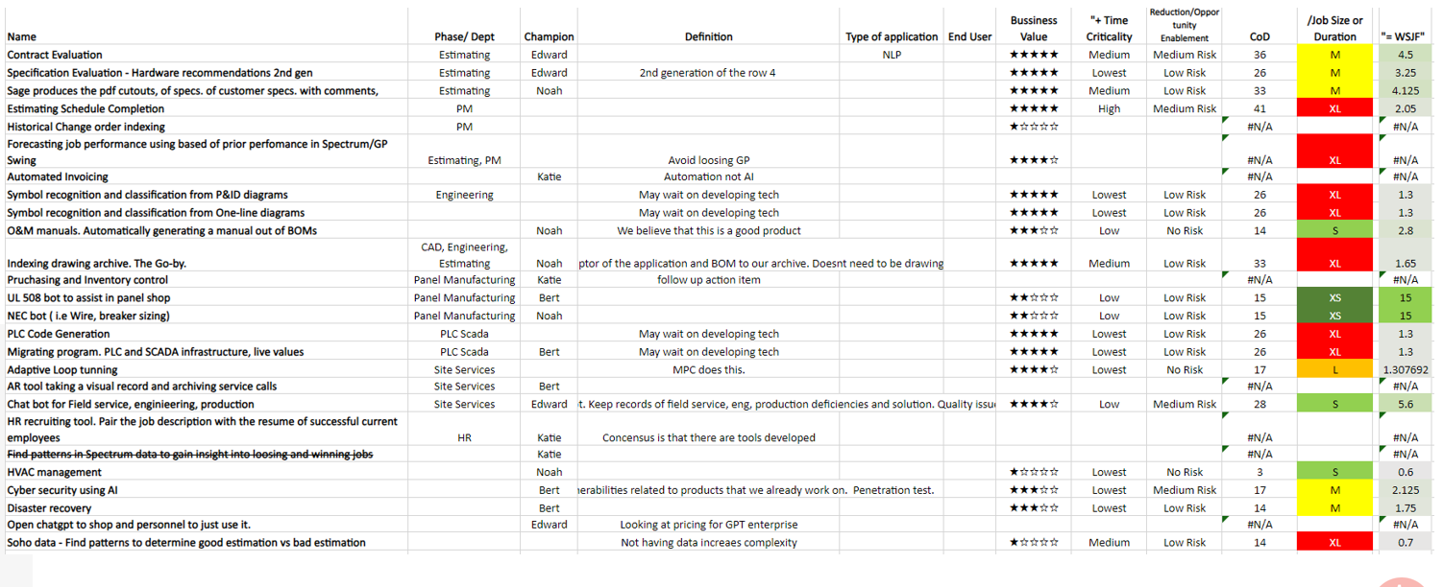
Selecting Focus Areas
Portfolio of potential focus areas

Slide 8
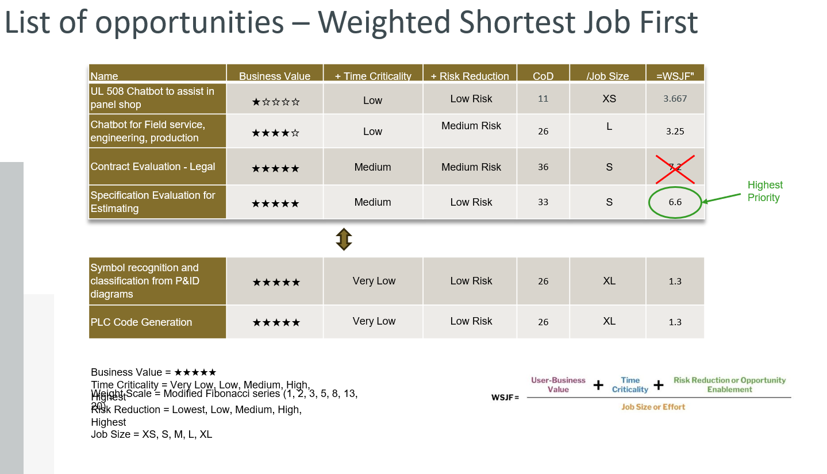
Selecting Focus Areas
“WSJF” method to prioritize

Slide 9
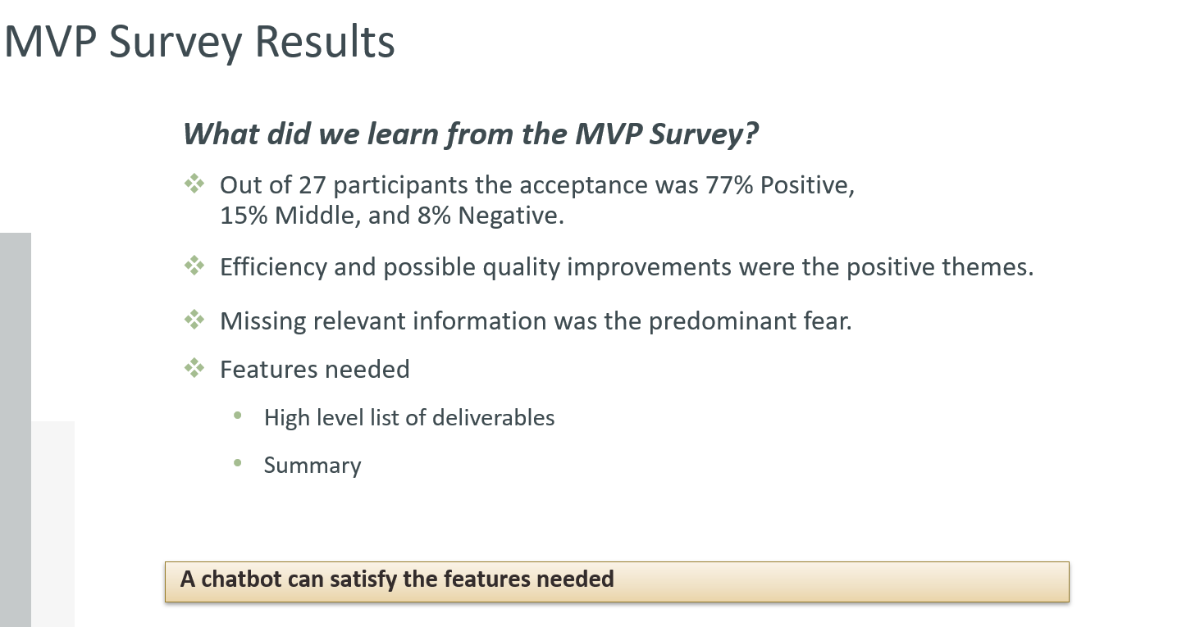
Selecting Focus Areas
Employee survey

Slide 10
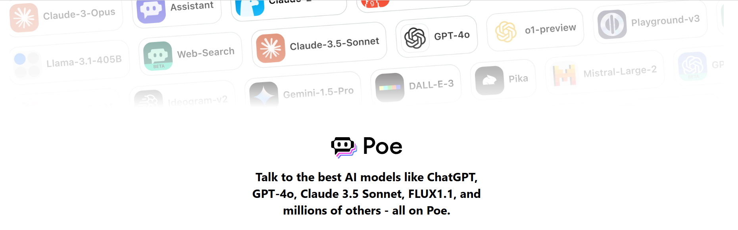
Poe App
Allows for use of many different AI for same monthly fee
Each AI has its strengths and weaknesses
AI models are evolving rapidly – don’t just choose 1
Different AI’s handle document types and prompts differently (i.e. engineering drawings)

Slide 11
Prompting and Questionnaires
Prompts
Training people to use effective prompts is critical
“Start fresh” – old query chains can skew output by perpetuating bias
Training is in the user, not the model
Trial and error
Questionnaires
Frame the required output from AI (i.e. summarizing elements of a document)
Developing robust context-based questionnaires to query AI is critical
Subject matter experts for each group
Living documents that are maintained and refined over time to become very reliable

Slide 12
Effective Prompts
Good resource for prompting best practices:
Be specific
“Act as if”
Specify output presentation
Use “do” and “don’t”
Use examples
Specify tone and audience
Build on previous prompts
Save for future use
https://huit.harvard.edu/news/ai-prompts
Use AI to build an AI prompt!

Slide 13
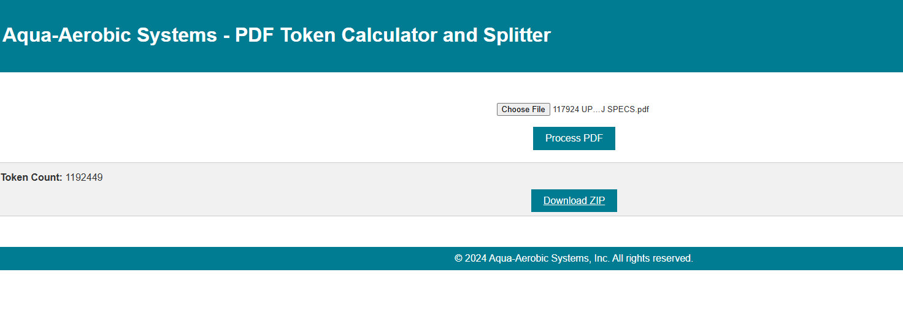
Token Calculator and PDF Splitter
Calculating token “weight” and splitting PDF is key
Pairing with appropriate AI “context window” to prevent coherency loss
Files with images have large token counts

Slide 14
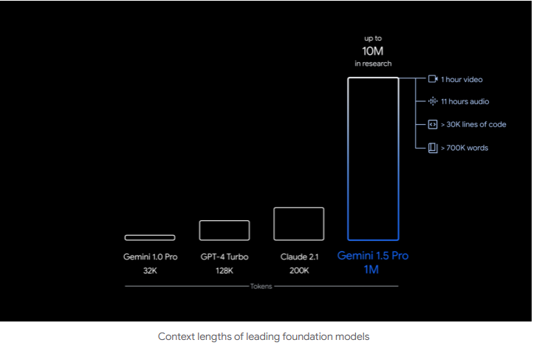
Context Window
# tokens a model can process in a single interaction
Gemini 1.5 Flash 1M

Slide 15
Revere – Spec Review Process
Poe AI Toolbox:
Offers various AI models for different use cases.
Uses Gemini 1.5 Flash 1M Model (1M refers to the number of tokens handled in one session).
Poe manages API tokens in the cloud.
Run PDF through Token Counter:
Example: PDF contains 700k tokens, Gemini model's limit is 1M tokens per question.
Run PDF through Splitter:
Splits PDF into sections to preserve tokens.
Smaller sections are easier for processing.
Load Question Set:
Uses predetermined prompts from a word document.
Starts fresh each session to avoid contamination.
Load Spec Review:
Copy and paste a premade prompt, such as “You are an engineer,” to focus LLM's perspective.
Generate Output:
Save the output into a text file and organize responses into a .csv file for further analysis.

Slide 16
Confidentiality and Copyright Protection
Best practice is to scrub docs of sensitive info. Can write a program to do this
Generally speaking, AI output is not copyright protected as it is computed by a generative model, therefore should be “original”. Many universities and company now allow it with proper citing
Regulations and legal analysis is evolving rapidly; may change in future
Enterprise AI versions have ability to create “closed” networks, but lose access to the global database (and costs more $)

Slide 17
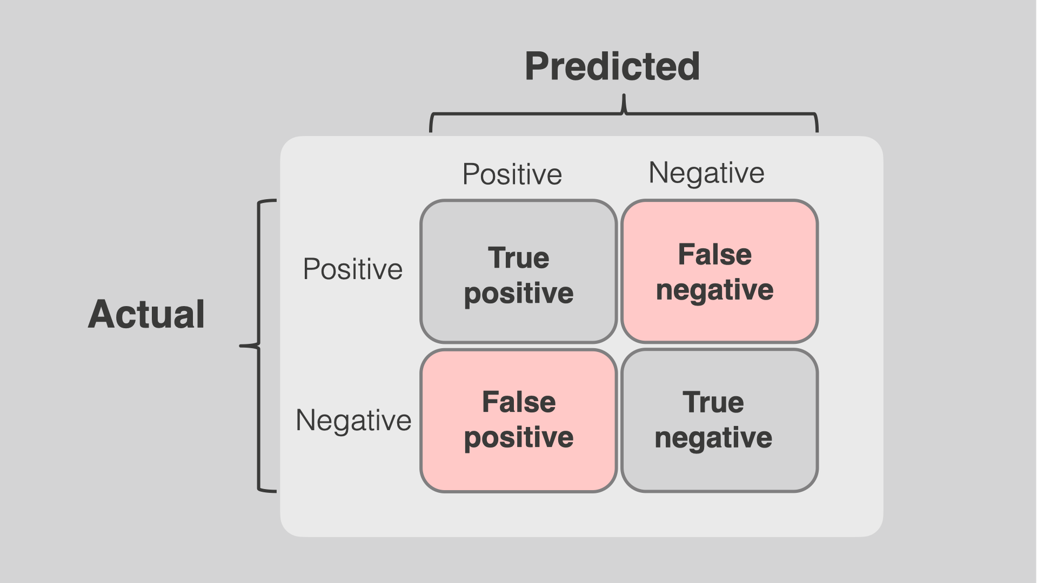
Accuracy Testing
How to trust and test the model?
Key part of implementation
Benchmark AI result vs human effectiveness (humans are not 100%)
Accuracy vs efficiency – how accurate does it need to be?
Depends on focus area and associated risk vs efficiencies gained
Confusion matrix approach
Subject Matter Experts to develop answer keys for scoring

Slide 18
Accuracy Testing
Define accuracy requirements.
Assess the relevance of items missed by AI and humans.
Evaluate time lost due to inaccuracies.

Slide 19
Overall Recommendations
Working Group should remain intact through testing, implementation, continuous improvement, etc. and meet regularly
Initial steps (testing, implementation, refinement) will take employee’s time; the Company needs to allow for this, plan appropriately and allocate resources
Select initial focus area(s)
Poe app should be rolled out in lieu of individual databases
Focus areas need a group representative to drive actions and identify sub-tasks

Slide 20
General Plan
SME Involvement is key
Rank/Identify Focus Areas
Output Testing (develop prompts & questionnaires)
Accuracy Testing
Initial Implementation to priority focus area(s)
Refinement / Continuous Improvement
Implement in Next Focus Areas
Working Group to identify sub-tasks
2-4 weeks
2-4 weeks
4-6 weeks
1-2 weeks
ongoing
After 3 months of use

Slide 21
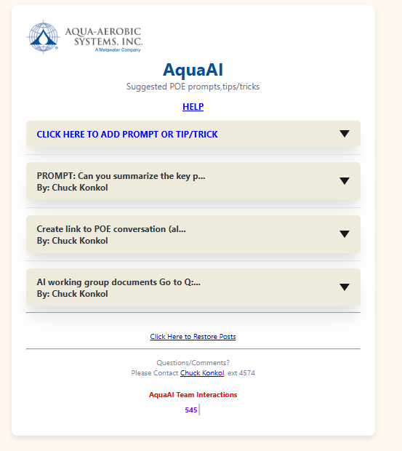
AquaAI Web App
https://aquaai.app/

Slide 22
Open Questions
Determine focus area selection methodology
Determine accuracy testing methodology

